Slide 1
Planning/Design Phase
Created a class diagram and a use case diagram
Cloned the git repo and inspected the file structure
Made sure to export/import classes as required
Added placeholder methods
Methods first, then tests
If needed, write a test to declare a problem to be solved by modifying the function
Notes:
Created a class diagram and a use case diagram – which I will show in a moment
I cloned the given git repo to gain a better understanding or what was expected of me in this project and what the file structure was like
I went through each class and added export/import statements to make sure that every class has access to what it needs
Added placeholders, Wrote the methods as blank, just to have a placeholder to check that it matched my class diagram and that nothing was missed
I decided to make my functions first, then the tests, then use my tests to improve/fix my functions if I felt there was something I needed to change or another exception to handle

Slide 2
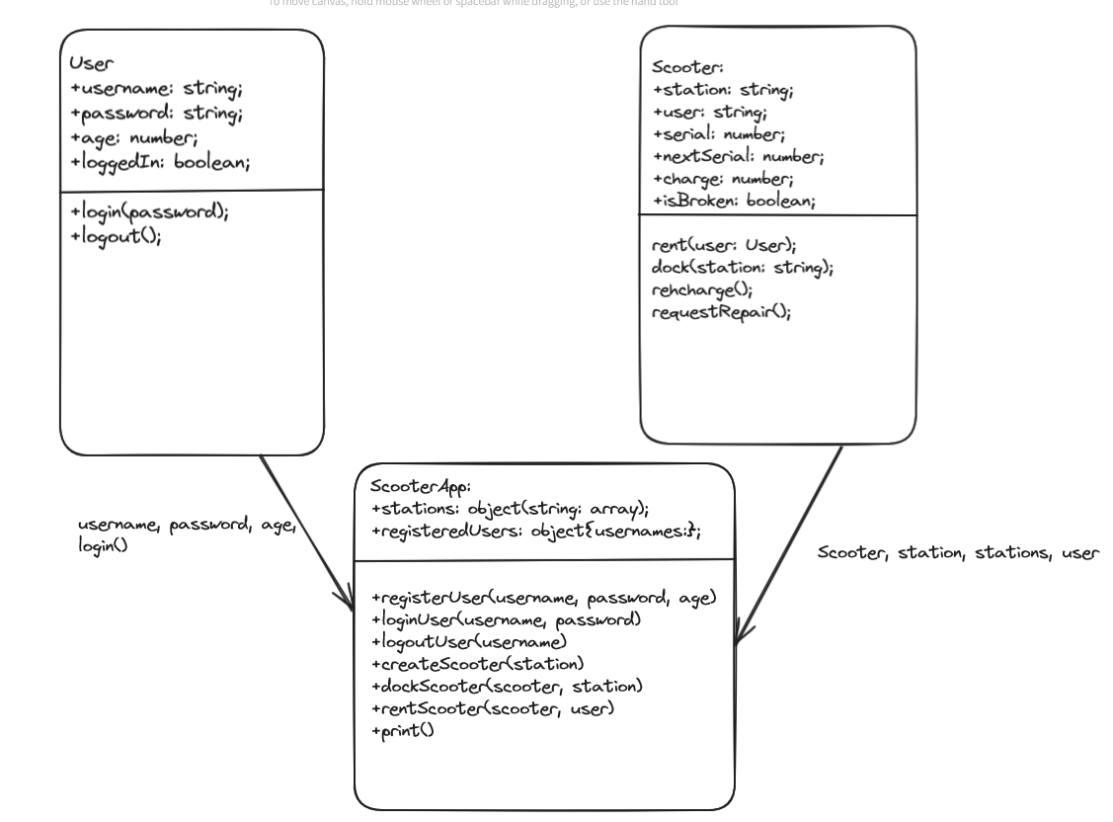

Slide 3
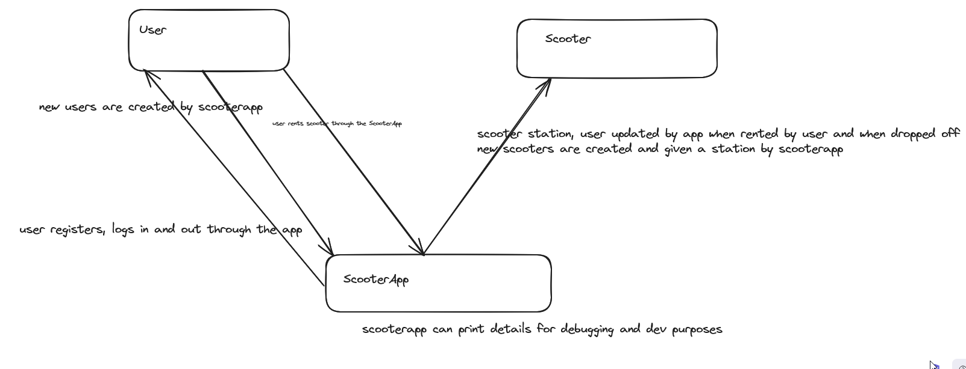

Slide 4
Implementation
This was my first foray into object-oriented programming (OOP)
Inputs to your functions may not be what you expect them to be!
Everything had to be commented rigorously
Notes:
This was my first foray into OOP - so I am pleased that I was able to get everything working between the different classes quite easily and that I accomplished all the objectives set out in the specification.
(referencing between different methods was a bit weird and accessing objects inside other objects was rather confusing, but once I got used to it became clear that it is quite a nice way to bundle your code up into manageable pieces
Unlike codewars or other previous tests, inputs are not what you expect them to be! – The most challenging part of the project to me was dealing with this: programming every sort of exception to be handled (which ends up being the bulk of the code)
As this is my first project which is expected to be viewed by others, everything is being rigorously commented, especially with respect to what is happening outside of the current block (i.e. in another class/file whatever)

Slide 5
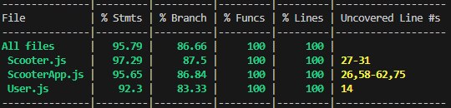
Testing
Static properties (nextSerial) causing issues
Tested using jest, using the node.js debugger and with console.log
Over 50 tests!
Tested that methods worked correctly, didn’t accept incorrect values and classes were all initialised properly
I learned how to use .toBe(), .toEqual(), .toThrow(), .toHaveProperty(), .toHaveLength(), .toBeNull() and .toHaveBeenCalledWith() in jest
I learned about extending the timeout on jest tests as this is necessary to test the asynchronous commands
Notes:
When I went to test nextSerial, I realised that as it was a static variable it meant that whenever I created a scooter anywhere within my ScooterApp test file, it would add to the serial number, so I was confused as to why my first scooter in my test had a serial number of 7. I realised I had to either move my serial number test to be the first test in the file, or just reset the serial number to 1 and then just check if it increments by one. I couldn’t think of a better solution sadly
I tested using jest, the node.js debugger in vscode and console.logging stuff where jest couldn’t fulfil my needs
I ended up writing over 50 tests, but sadly still didn’t manage to reach 100% coverage
Tested that methods worked correctly, didn’t accept incorrect values and classes were all initialised properly
I learned all the different ways we can check the expected output from various statements in jest, I mostly used toBe and toThrow for checking values and for errors
The default jest timeout for test is 5 seconds, which for the request repair function is the minimum time it can take to finish, so this had to be extended in order to test this one properly

Slide 6
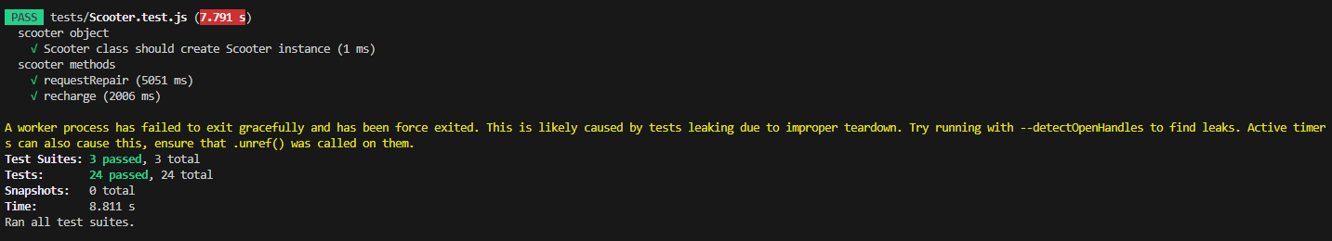
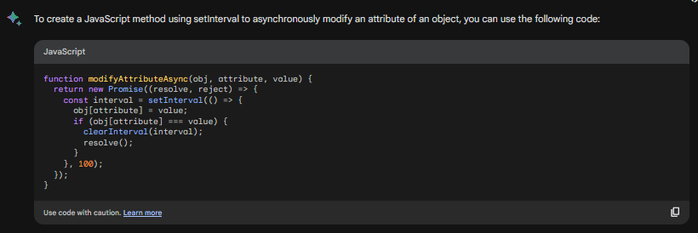
Notes:
(next slide) I had an issue when testing my original request repair function, it resulted in an error saying that a worker process failed to exit gracefully.
From googling, it seems that I had to implement a clearInterval() statement which I couldn’t get the syntax quite right on. So I called upon google bard to help me, which was able to help me fix my syntax and understand the way to write these methods in a better way, and how to test them using jest. This was my first time using AI to write code and I found it very useful.
For example, in this slide at the top we can see that one of my jest tests returned an error saying that a worker process failed to exit gracefully. It seemed this was from an unfulfilled promise. I am not familiar with asynchronous javascript, so I was attempting to implement a clearInterval() statement after a promise is fulfilled, but I couldn’t quite get it right. A lot of the tutorials involving this method were written through a more web-oriented view. Therefore, I decided to use google bard to help me write this code. After seeing this code it made it a bit more clear how I was supposed to implement this feature and it also showed me how to test it using jest. This was my first time ever using AI to help me write code and I think it is just like finding a stackoverflow post that happens to answer your exact question. Which is helpful, especially when that stackoverflow post doesn’t exist.

Slide 7
What would I do differently next time?
Consider more carefully what the project will have to look like upon finishing
Implement private values for variables that I didn’t want to change accidentally
Improve my class and use case diagrams to improve my workflow
Notes:
Most likely consider more carefully what the project will have to look like upon finishing, as my current one has no static stations or registeredusers, so only really works for one ScooterApp instance as these are then different for each scooterapp, sadly I had no time to fix these.
I would also implement private values for variables that I didn’t want to change accidentally, but as they are a bit fiddly didn’t want to do them for this project as I didn’t have much time.
Now my understanding of OOP is greatly improved, my class and use case diagrams would be a lot better than those that I used in this project, if I were to do it again, this would lead to them being much more accurate and thorough to which would help improve my workflow

